Slide 1
DATA COLLECTION

Slide 2
Variables/Parameters
Population
Land Surface Temperature (LST)
Precipitation
Air Quality

Slide 3
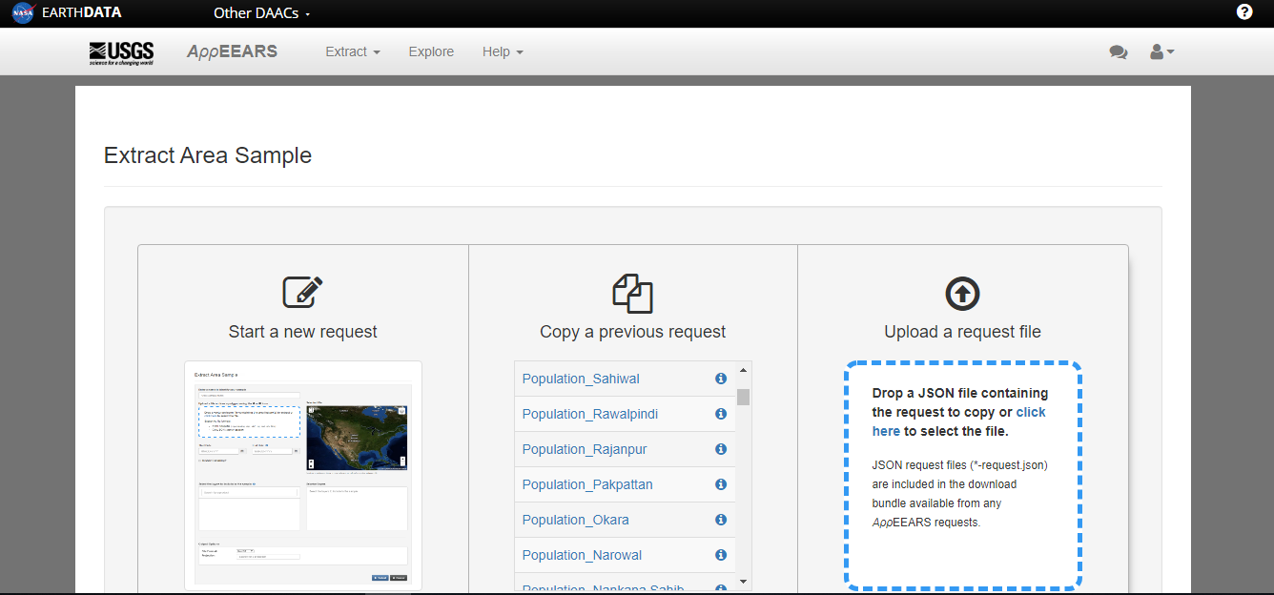
Data collection
Range: 2010-2019
Website Used:
AppEEARS – USGS

Slide 4
Selecting data product
Population
Gridded Population of the World (GPW)
Range: 2010,2015,2020
LST
16 days MODIS data for June and December
Range: 2010-2019

Slide 5
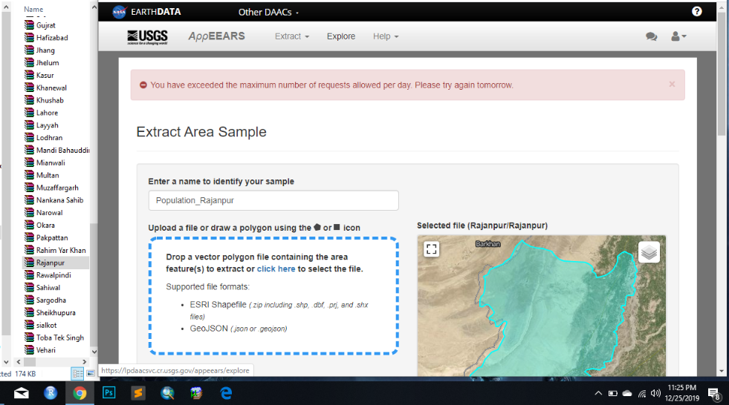
Methodology
Signing up for Appeears
Creating new data request
Selecting area sample
Selecting title
Uploading shape or required region
Selecting data product
For LST we use 16 days MODIS data for June and December)
For population: Gridded Population of the World (GPW))

Slide 6
Methodology
Selecting projection system
Selecting output format
Submitting request
Downloading data
Repeating each process for all districts separately
Separating “mean” data from excel file

